Slide 1
EECS 490 – Lecture 13 Operational Semantics

Slide 2
Announcements
HW3 due tomorrow at 8pm
Project 3 due 10/17 at 8pm

Slide 3
Semantics
Syntax is concerned with the structure of programs, while semantics is concerned with their meaning
Semantics can be described formally
Denotational semantics: program behavior described using set and domain theory and partial functions over program state
Axiomatic semantics: concerned with proving logical assertions over program state, so meaning specified with respect to the effect on these logical assertions
Operational semantics: specifies what each computational step does to the state of a program, and what value it computes
We will look at a specific form of operational semantics known as natural or big-step semantics

Slide 4
Language
We will use a simple imperative language: P → S S → skip | S; S | V = A | if B then S else S end | while B do S end A → N | V | (A + A) | (A − A) | (A * A)
Boolean expressions
B → true | false | (A <= A) | (B and B ) | not B V → Identifier N → Integer
Statements
Variables
Arithmetic expressions
Numbers

Slide 5
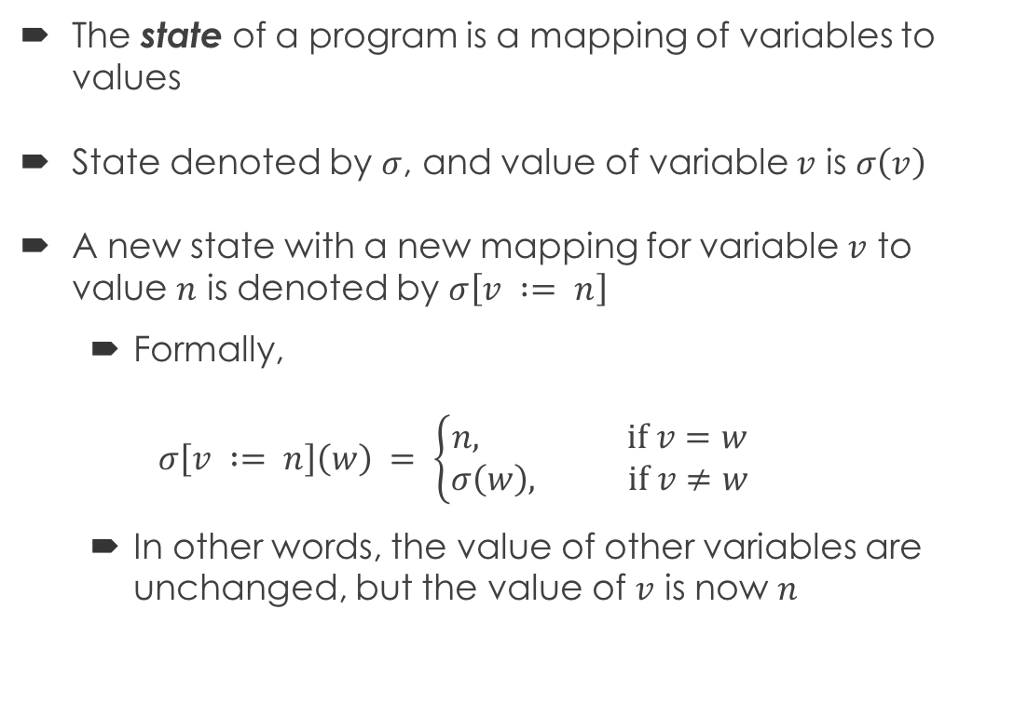
States
The state of a program is a mapping of variables to values
State denoted by $σ$, and value of variable $v$ is $σ\left(v\right)$
A new state with a new mapping for variable $v$ to value $n$ is denoted by $σ\left[v := n\right]$
Formally, $σ\left[v := n\right]\left(w\right) = \left\{\begin{aligned}n, if v=w \\ σ\left(w\right), if v≠w\end{aligned}\right.$
In other words, the value of other variables are unchanged, but the value of $v$ is now $n$

Slide 6
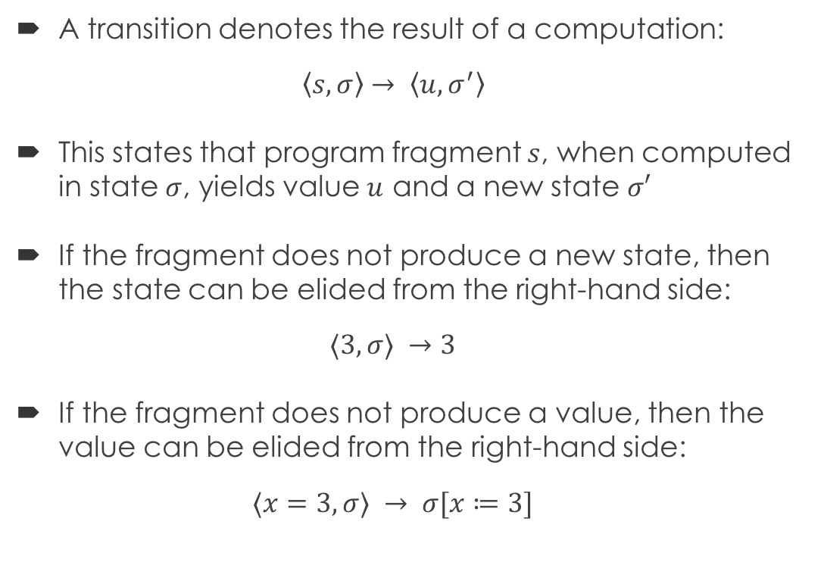
Transitions
A transition denotes the result of a computation: $\left\langle s,σ\right\rangle → \left\langle u,σ^{′}\right\rangle$
This states that program fragment $s$, when computed in state $σ$, yields value $u$ and a new state $σ′$
If the fragment does not produce a new state, then the state can be elided from the right-hand side: $⟨3,σ⟩ →3$
If the fragment does not produce a value, then the value can be elided from the right-hand side: $⟨x=3,σ⟩ → σ[x≔3]$

Slide 7
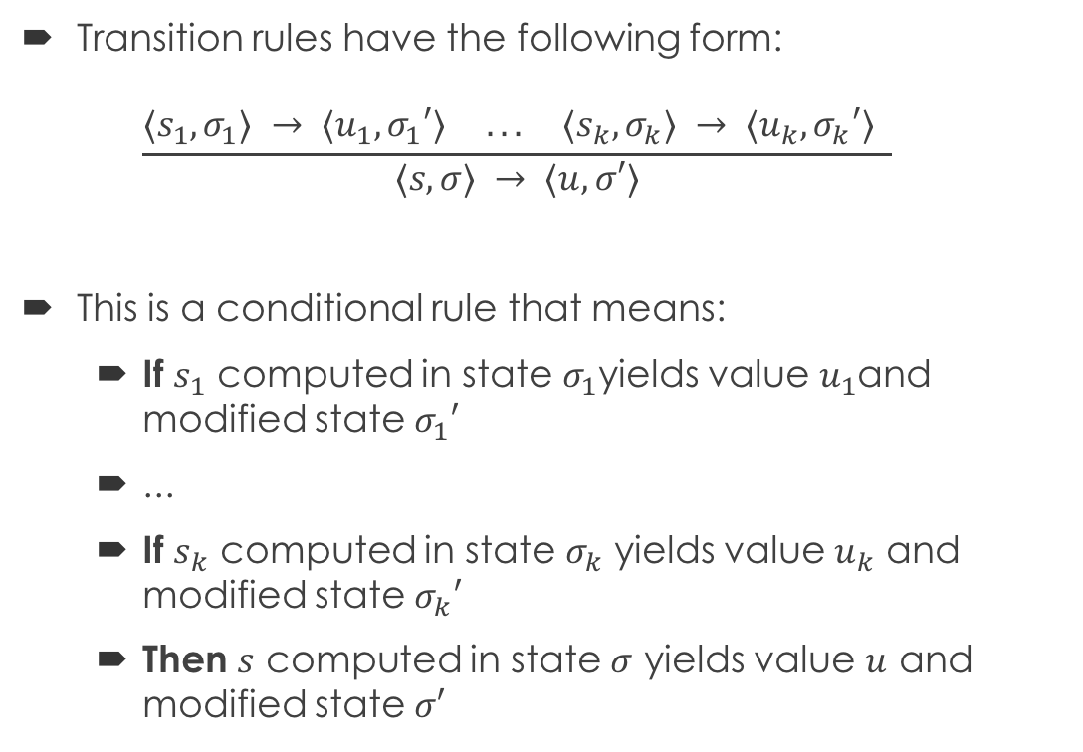
Transition Rules
Transition rules have the following form: $\frac{⟨s_{1},σ_{1}⟩ → ⟨u_{1},σ_{1}′⟩ ... ⟨s_{k},σ_{k}⟩ → ⟨u_{k},σ_{k}′⟩ }{⟨s,σ⟩ → ⟨u,σ′⟩}$
This is a conditional rule that means:
If $s_{1}$ computed in state $σ_{1}$yields value $u_{1}$and modified state $σ_{1}′$
...
If $s_{k}$ computed in state $σ_{k}$ yields value $u_{k}$ and modified state $σ_{k}′$
Then $s$ computed in state $σ$ yields value $u$ and modified state $σ′$
Premise
Conclusion
Transition

Slide 8
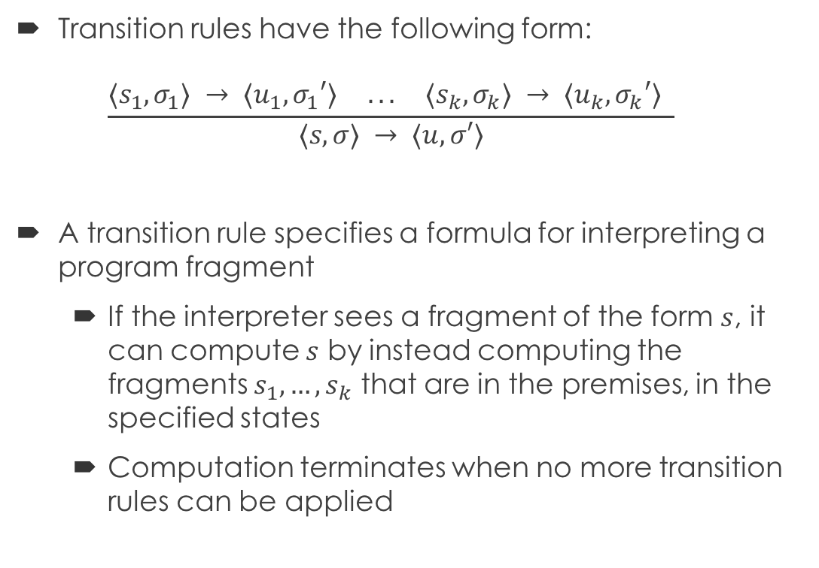
Interpretation
Transition rules have the following form: $\frac{⟨s_{1},σ_{1}⟩ → ⟨u_{1},σ_{1}′⟩ ... ⟨s_{k},σ_{k}⟩ → ⟨u_{k},σ_{k}′⟩ }{⟨s,σ⟩ → ⟨u,σ′⟩}$
A transition rule specifies a formula for interpreting a program fragment
If the interpreter sees a fragment of the form $s$, it can compute $s$ by instead computing the fragments $s_{1},…,s_{k}$ that are in the premises, in the specified states
Computation terminates when no more transition rules can be applied

Slide 9
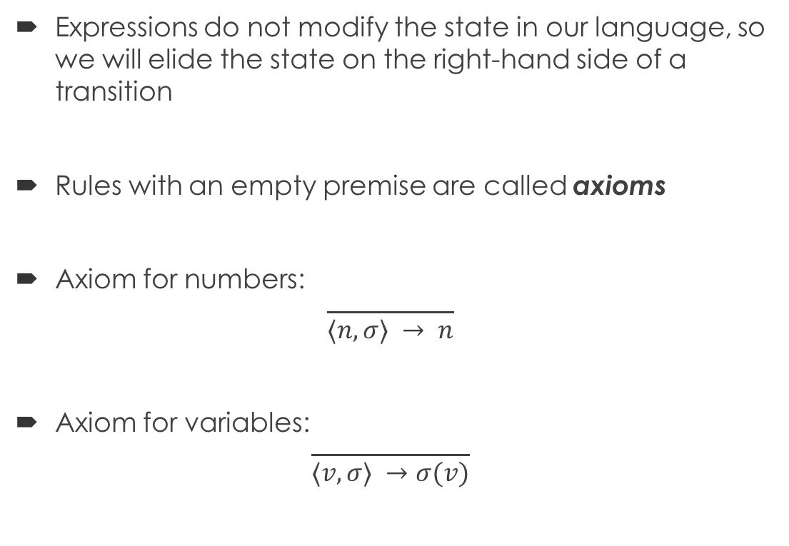
Expressions
Expressions do not modify the state in our language, so we will elide the state on the right-hand side of a transition
Rules with an empty premise are called axioms
Axiom for numbers: $\frac{ }{⟨n,σ⟩ → n}$
Axiom for variables: $\frac{ }{⟨v,σ⟩ →σ(v)}$
Notes:
Number evaluates to itself. Variable evaluates to its value in the state. Notice how these rules match what you did in the Scheme interpreter

Slide 10
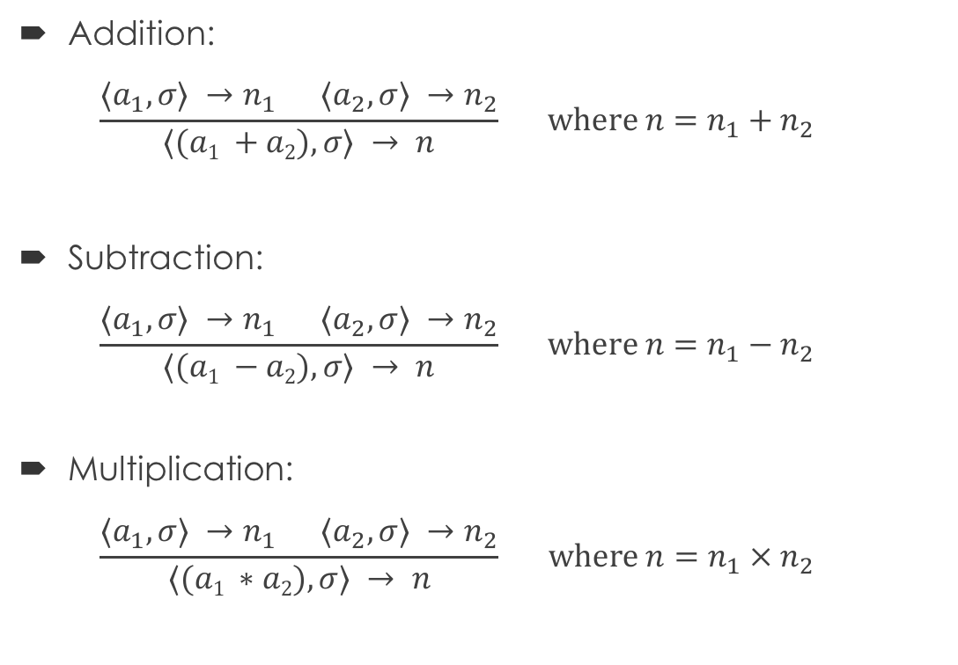
Arithmetic Expressions
Addition: $\frac{⟨a_{1},σ⟩ →n_{1} ⟨a_{2},σ⟩ →n_{2}}{⟨(a1 +a2),σ⟩ → n} where n=n_{1}+n_{2}$
Subtraction: $\frac{⟨a_{1},σ⟩ →n_{1} ⟨a_{2},σ⟩ →n_{2}}{⟨(a1 −a2),σ⟩ → n} where n=n_{1}−n_{2}$
Multiplication: $\frac{⟨a_{1},σ⟩ →n_{1} ⟨a_{2},σ⟩ →n_{2}}{⟨(a1 ∗a2),σ⟩ → n} where n=n_{1} × n_{2}$

Slide 11
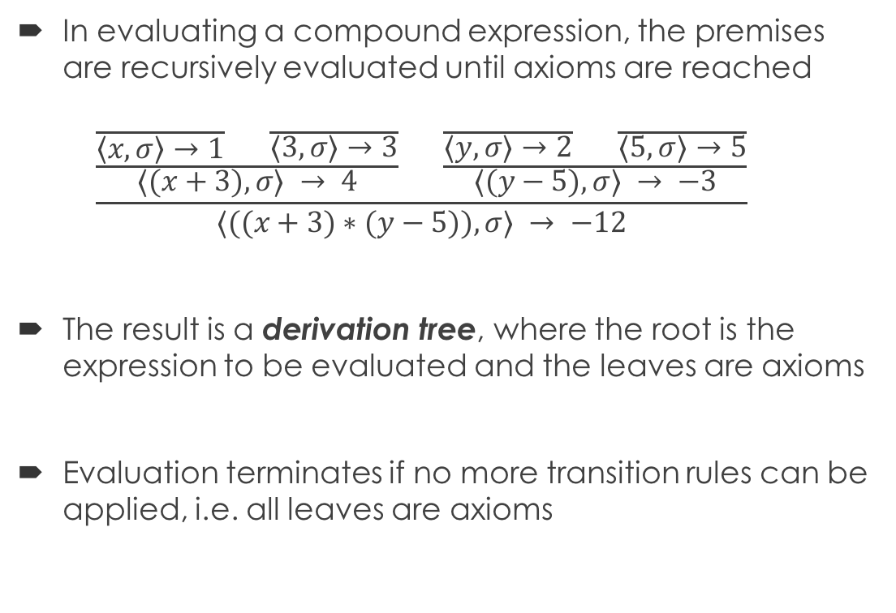
Evaluation
In evaluating a compound expression, the premises are recursively evaluated until axioms are reached $\frac{\frac{\frac{ }{\left\langle x,σ\right\rangle →1} \frac{ }{⟨3,σ⟩→3}}{⟨(x+3),σ⟩ → 4} \frac{\frac{ }{⟨y,σ⟩→2} \frac{ }{⟨5,σ⟩→5}}{⟨(y−5),σ⟩ → −3}}{⟨((x+3)∗(y−5)),σ⟩ → −12}$
The result is a derivation tree, where the root is the expression to be evaluated and the leaves are axioms
Evaluation terminates if no more transition rules can be applied, i.e. all leaves are axioms

Slide 12

Example
Derivation tree for $(\left(x∗3\right)−2)$:

Slide 13
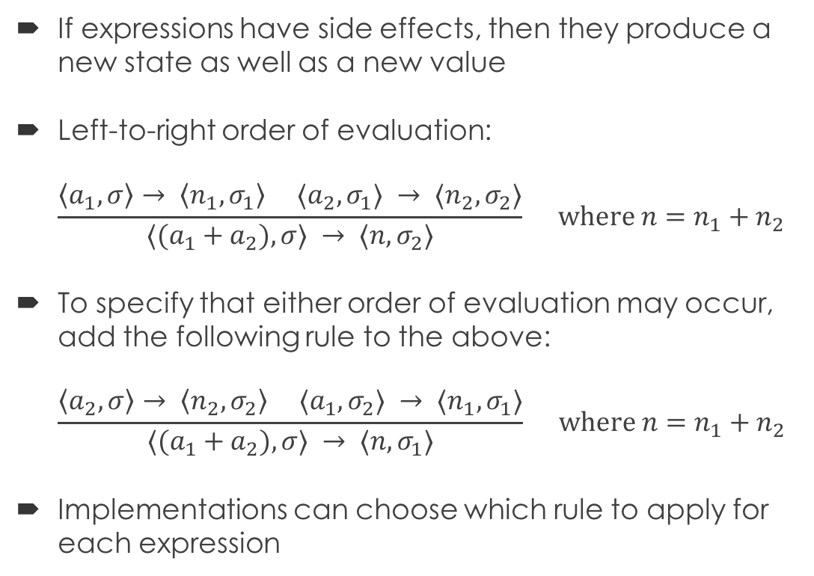
Order of Evaluation
If expressions have side effects, then they produce a new state as well as a new value
Left-to-right order of evaluation: $\frac{\left\langle a_{1},σ\right\rangle → \left\langle n_{1},σ_{1}\right\rangle ⟨a_{2},σ_{1}⟩ → ⟨n_{2},σ_{2}⟩}{⟨(a_{1}+a_{2}),σ⟩ → ⟨n,σ_{2}⟩} where n=n_{1}+n_{2}$
To specify that either order of evaluation may occur, add the following rule to the above: $\frac{\left\langle a_{2},σ\right\rangle → \left\langle n_{2},σ_{2}\right\rangle ⟨a_{1},σ_{2}⟩ → ⟨n_{1},σ_{1}⟩}{⟨(a_{1}+a_{2}),σ⟩ → ⟨n,σ_{1}⟩} where n=n_{1}+n_{2}$
Implementations can choose which rule to apply for each expression

Slide 14
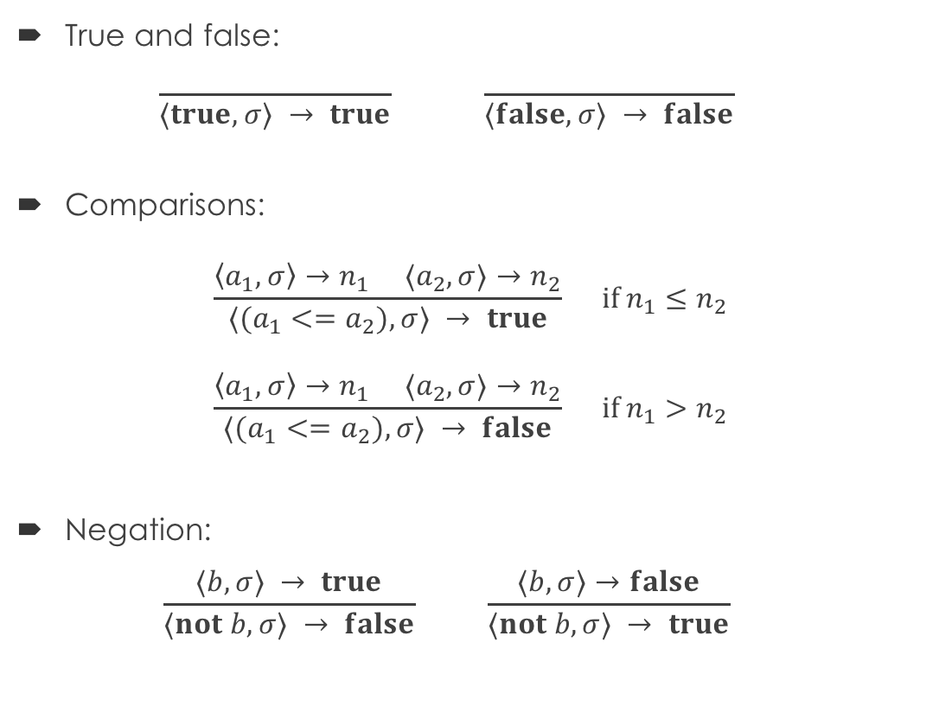
Boolean Expressions
True and false: $\frac{ }{⟨true, σ⟩ → true} \frac{ }{⟨false, σ⟩ → false}$
Comparisons:
$$\frac{\left\langle a_{1},σ\right\rangle →n_{1} ⟨a_{2},σ⟩→n_{2}}{⟨(a_{1}<=a_{2}),σ⟩ → true} if n_{1}≤n_{2}$$
$$\frac{\left\langle a_{1},σ\right\rangle →n_{1} ⟨a_{2},σ⟩→n_{2}}{⟨(a_{1}<=a_{2}),σ⟩ → false} if n_{1}>n_{2}$$
Negation: $\frac{⟨b,σ⟩ → true}{⟨not b,σ⟩ → false} \frac{⟨b,σ⟩→false}{⟨not b,σ⟩ → true}$

Slide 15
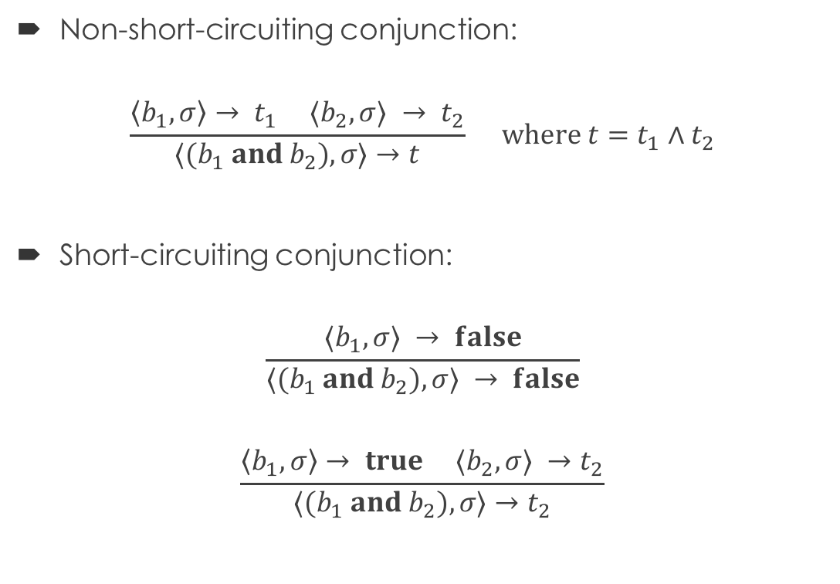
Conjunction
Non-short-circuiting conjunction:
$$\frac{\left\langle b_{1},σ\right\rangle → t_{1} ⟨b_{2},σ⟩ → t_{2}}{⟨(b_{1} and b_{2}),σ⟩→t} where t=t_{1}∧t_{2}$$
Short-circuiting conjunction:
$$\frac{⟨b_{1},σ⟩ → false}{⟨(b_{1} and b_{2}),σ⟩ → false}$$
$$\frac{\left\langle b_{1},σ\right\rangle → true ⟨b_{2},σ⟩ →t_{2}}{⟨(b_{1} and b_{2}),σ⟩→t_{2}}$$

Slide 16
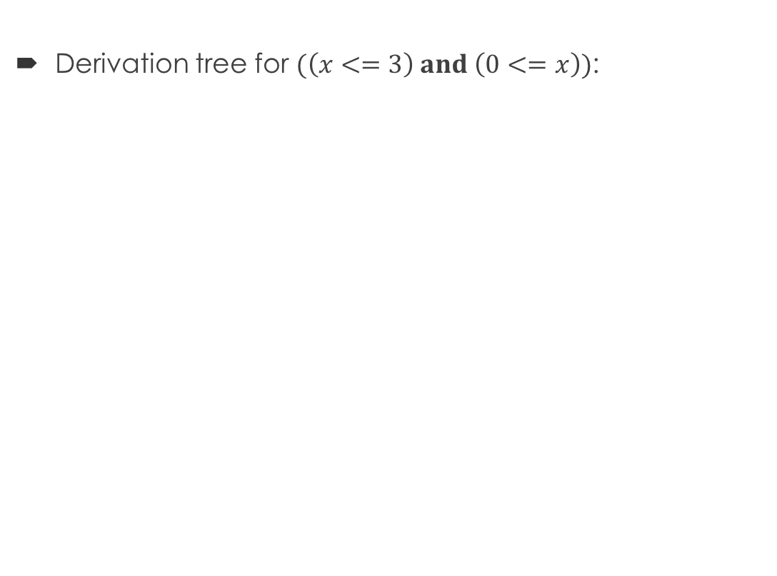
Example
Derivation tree for $(\left(x<=3\right) and \left(0<=x\right))$:

Slide 17
Break Time!
We’ll start again in five minutes.

Slide 18
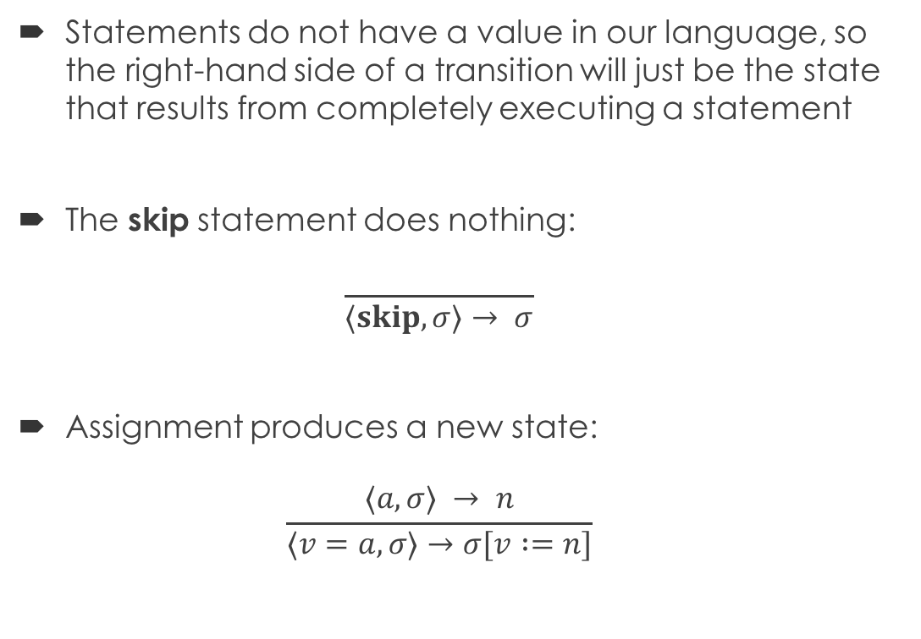
Statements
Statements do not have a value in our language, so the right-hand side of a transition will just be the state that results from completely executing a statement
The skip statement does nothing: $\frac{ }{⟨skip,σ⟩→ σ}$
Assignment produces a new state: $\frac{⟨a,σ⟩ → n}{⟨v=a,σ⟩→σ[v :=n]}$

Slide 19
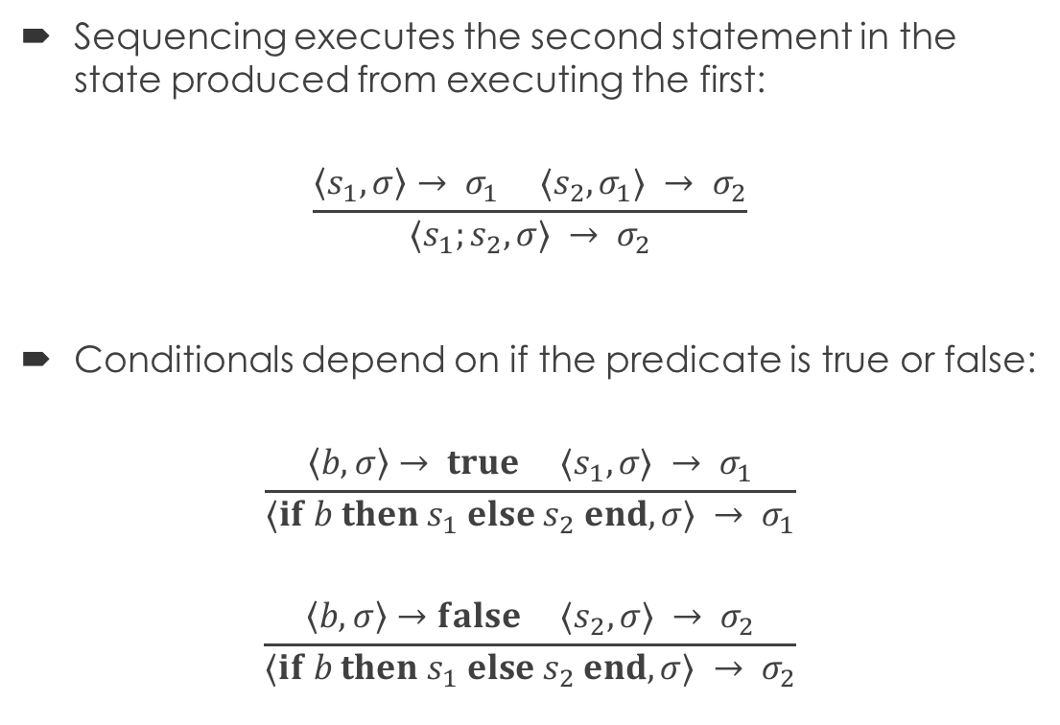
Sequencing and Conditionals
Sequencing executes the second statement in the state produced from executing the first:
$$\frac{\left\langle s_{1},σ\right\rangle → σ_{1} ⟨s_{2},σ_{1}⟩ → σ_{2}}{⟨s_{1};s_{2},σ⟩ → σ_{2}}$$
Conditionals depend on if the predicate is true or false:
$$\frac{\left\langle b,σ\right\rangle → true ⟨s_{1},σ⟩ → σ_{1}}{⟨if b then s_{1} else s_{2} end,σ⟩ → σ_{1}}$$
$$\frac{\left\langle b,σ\right\rangle →false ⟨s_{2},σ⟩ → σ_{2}}{⟨if b then s_{1} else s_{2} end,σ⟩ → σ_{2}}$$

Slide 20
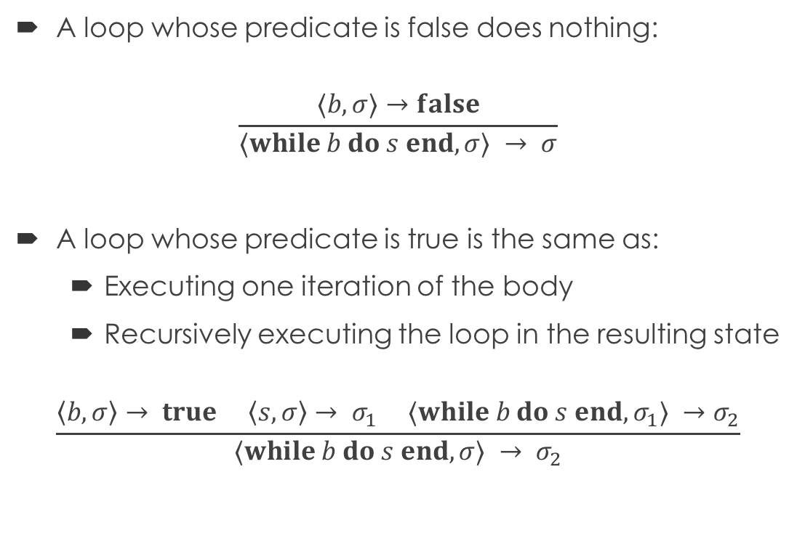
Loops
A loop whose predicate is false does nothing:
$$\frac{⟨b,σ⟩→false}{⟨while b do s end,σ⟩ → σ}$$
A loop whose predicate is true is the same as:
Executing one iteration of the body
Recursively executing the loop in the resulting state
$$\frac{\left\langle b,σ\right\rangle → true \left\langle s,σ\right\rangle → σ_{1} ⟨while b do s end,σ_{1}⟩ →σ_{2}}{⟨while b do s end,σ⟩ → σ_{2}}$$

Slide 21
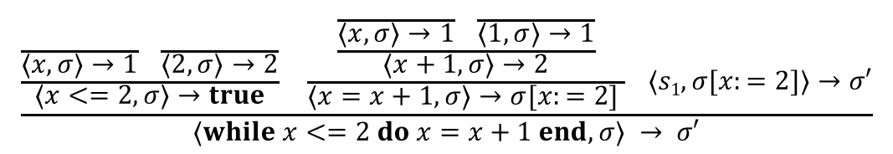
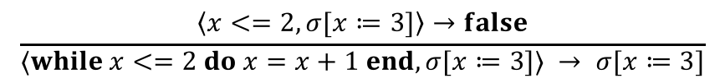
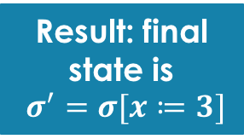

Example: Loop
x = 1;
while (x <= 2) do x = (x + 1) end
Apply transition rule for while: where $s1=\left[while x<=2 do x=x+1 end\right]$
Recursively executing $s1$ in $σ[x:=2]$:
Another recursive execution of $s1$, now in $σ[x≔3]$:
$$\frac{\frac{\frac{ }{⟨x,σ⟩→1} \frac{ }{⟨2,σ⟩→2}}{⟨x<=2,σ⟩→true} \frac{\frac{\frac{ }{⟨x,σ⟩→1} \frac{ }{⟨1,σ⟩→1}}{⟨x+1,σ⟩→2}}{⟨x=x+1,σ⟩→σ[x:=2] } ⟨s1,σ[x:=2]⟩→σ′}{⟨while x<=2 do x=x+1 end, σ⟩ → σ′}$$
$$\frac{\left\langle x<=2,σ[x≔2]\right\rangle →true \left\langle x=x+1,σ[x≔2]\right\rangle →σ\left[x≔3\right] ⟨s1,σ[x≔3]⟩→σ′}{⟨while x<=2 do x=x+1 end, σ[x≔2]⟩ → σ′}$$
Result: final state is
$σ^{′}=σ[x≔3]$
$$\frac{\left\langle x<=2,σ[x≔3]\right\rangle →false}{⟨while x<=2 do x=x+1 end, σ[x≔3]⟩ → σ[x≔3]}$$

Slide 22
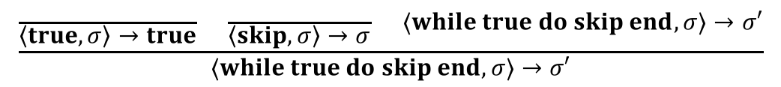
Example: Divergent Loop
while true do skip end
Apply transition rule for while:
Recursive execution of the new loop results in same exact computation as above
The computation is divergent, since it never terminates
$$\frac{\frac{ }{\left\langle true,σ\right\rangle →true} \frac{ }{\left\langle skip,σ\right\rangle →σ} ⟨while true do skip end, σ⟩→σ′}{⟨while true do skip end, σ⟩→σ′}$$

Slide 23
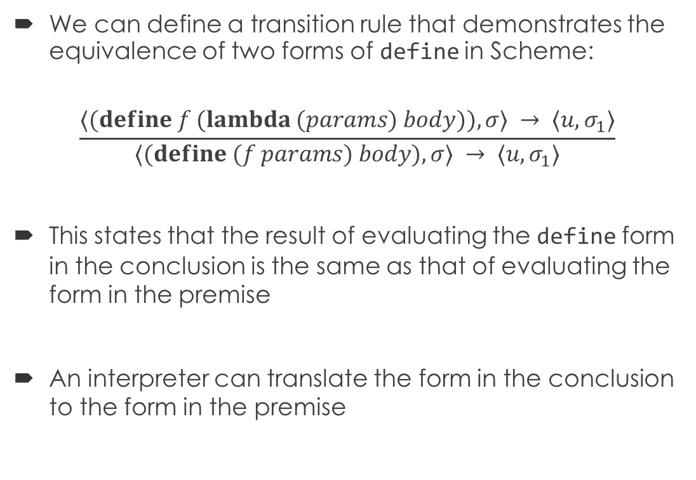
Example: Scheme define
We can define a transition rule that demonstrates the equivalence of two forms of define in Scheme:
$$\frac{⟨(define f (lambda (params) body)),σ⟩ → ⟨u,σ_{1}⟩}{⟨(define (f params) body),σ⟩ → ⟨u,σ_{1}⟩}$$
This states that the result of evaluating the define form in the conclusion is the same as that of evaluating the form in the premise
An interpreter can translate the form in the conclusion to the form in the premise
Notes:
How many of you did this in your Scheme interpreter?

Slide 24
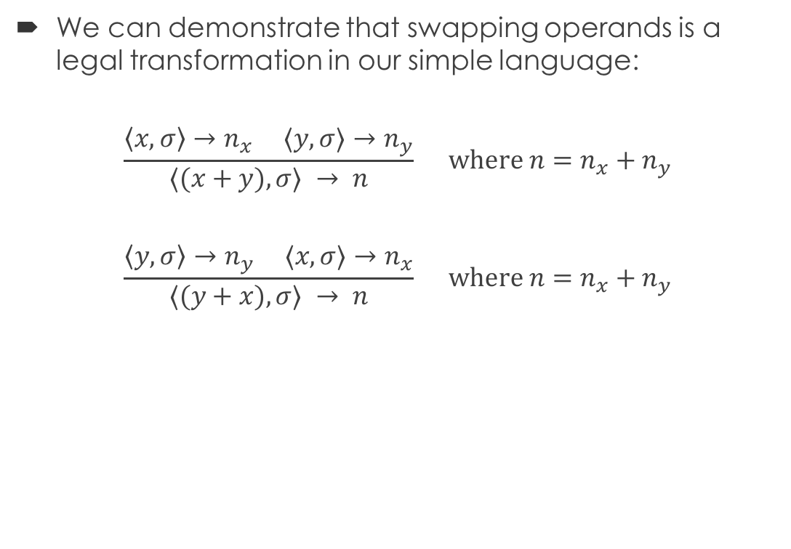
Example: Swapping Operands
We can demonstrate that swapping operands is a legal transformation in our simple language:
$$\frac{\left\langle x,σ\right\rangle →n_{x} ⟨y,σ⟩→n_{y}}{⟨(x+y),σ⟩ → n} where n=n_{x}+n_{y}$$
$$\frac{\left\langle y,σ\right\rangle →n_{y} ⟨x,σ⟩→n_{x}}{⟨(y+x),σ⟩ → n} where n=n_{x}+n_{y}$$
By commutativity of integer addition

Slide 25
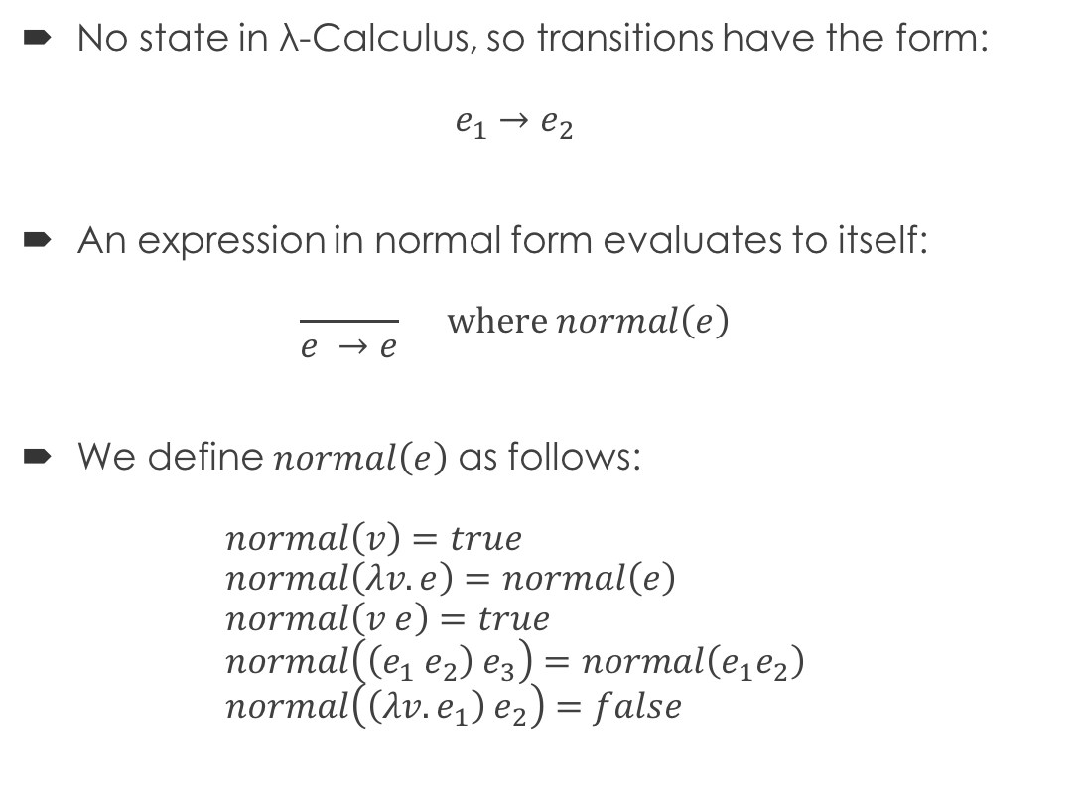
Semantics for λ-Calculus
No state in λ-Calculus, so transitions have the form: $e_{1}→e_{2}$
An expression in normal form evaluates to itself: $\frac{ }{e →e} where normal\left(e\right)$
We define $normal\left(e\right)$ as follows: $normal\left(v\right)=true$ $normal\left(λv. e\right)=normal\left(e\right)$ $normal\left(v e\right)=true$ $normal\left(\left(e_{1} e_{2}\right){ e}_{3}\right)=normal\left(e_{1}e_{2}\right)$ $normal\left(\left(λv.e_{1}\right) e_{2}\right)=false$

Slide 26
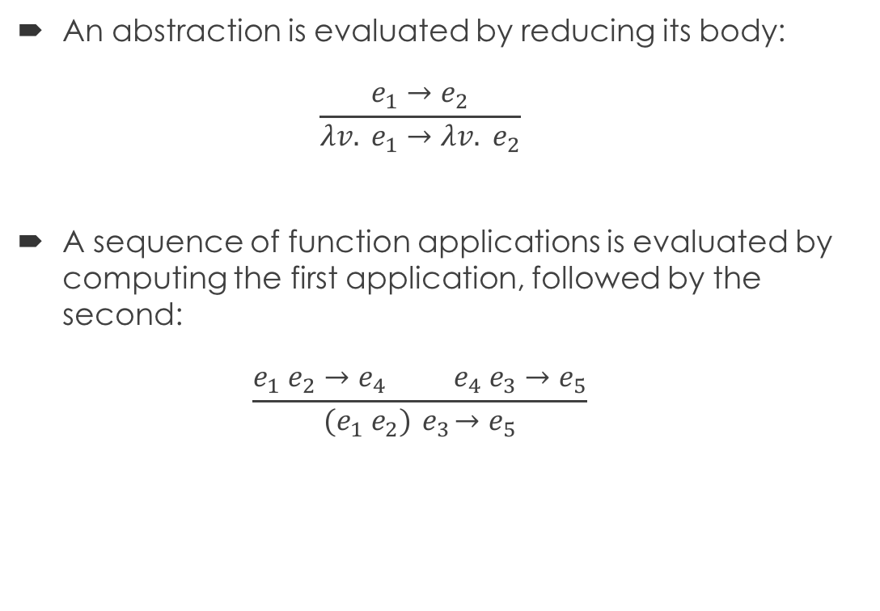
Semantics for λ-Calculus
An abstraction is evaluated by reducing its body: $\frac{e_{1}→e_{2}}{{λv. e}_{1}→λv. e_{2}}$
A sequence of function applications is evaluated by computing the first application, followed by the second: $\frac{e_{1} e_{2}→e_{4} e_{4} e_{3}→e_{5}}{(e_{1} e_{2}){ e}_{3}→e_{5}}$

Slide 27
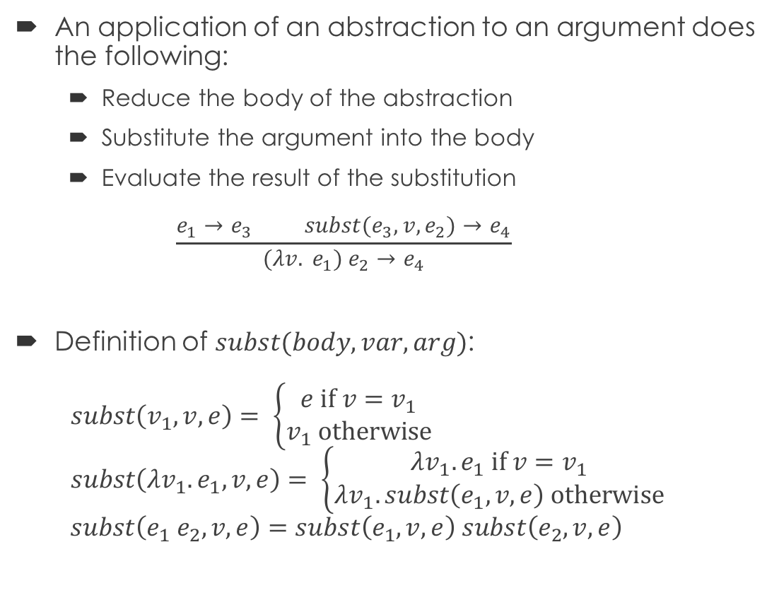
Semantics for λ-Calculus
An application of an abstraction to an argument does the following:
Reduce the body of the abstraction
Substitute the argument into the body
Evaluate the result of the substitution $\frac{e_{1}→e_{3} subst(e_{3}, v,e_{2})→e_{4}}{{(λv. e}_{1}) e_{2}→e_{4}}$
Definition of $subst(body, var, arg)$: $subst\left(v_{1}, v,e\right)= \left\{\begin{aligned}e if v=v_{1} \\ v_{1} otherwise\end{aligned}\right.$ $subst\left(λv_{1}.e_{1}, v,e\right)= \left\{\begin{aligned}λv_{1}.e_{1} if v=v_{1} \\ λv_{1}.subst\left(e_{1}, v, e\right) otherwise\end{aligned}\right.$ $subst\left(e_{1}{ e}_{2}, v,e\right)=subst\left(e_{1}, v,e\right) subst\left(e_{2}, v,e\right)$

